Slide 1

Introduction to CoffeeScript

Slide 2
What is CoffeeScript
A language
An abstraction of JavaScript
compiles down to JavaScript
obeys JavaScript rules (to an extent)
obscures JavaScript “flaws”

Slide 3
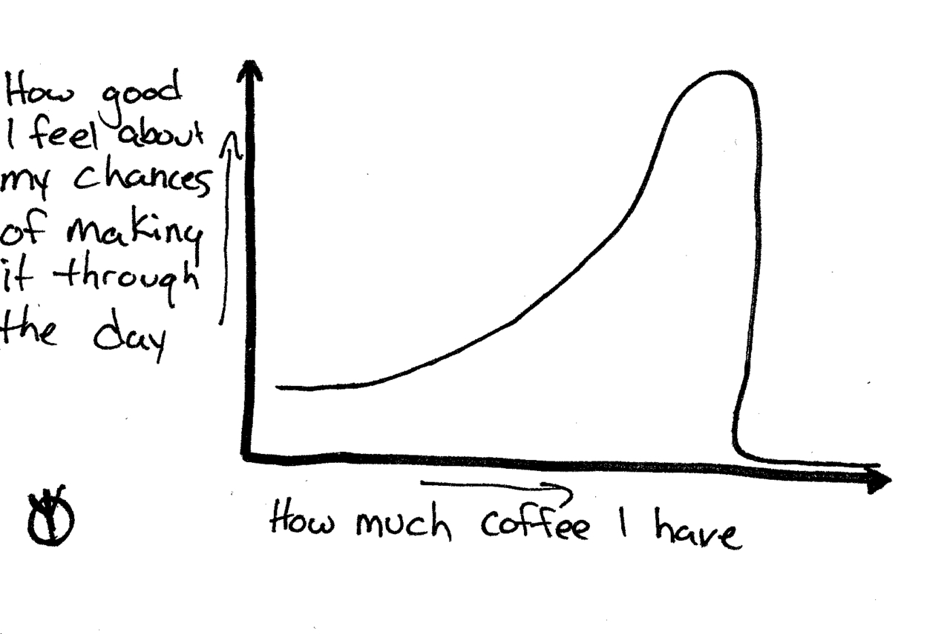

Slide 4
Caffeinated Advantages!
Terse syntax
Useful language features borrowed from Ruby, Python, etc.
More familiar OOP-style syntax if you want to work with classes
By default, prevents you from creating variables in the global scope
JavaScript libraries can be called from within CoffeeScript
REPL console

Slide 5
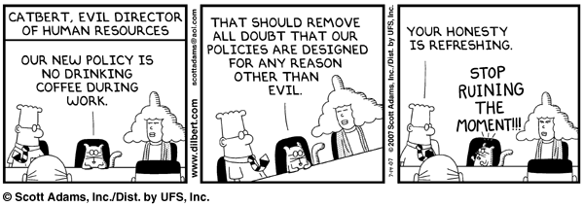

Slide 6
Caffeinated Disadvantages!
You need to understand two languages, not just one
Runtime errors occur in compiled JavaScript, not CoffeeScript source
OOP-style syntax still obeys JavaScript scoping rules (this will mess with your head)
CoffeeScript compiler doesn’t generate the best error messages

Slide 7


Slide 8
Windows Setup
Node.js and CoffeeScript source from Github
CoffeeScript Compiler for Windows
Default extension for CoffeeScript files is .coffee
coffee --compile file
coffee --watch --compile dir1 dir2 dir3

Slide 9


Slide 10
How do I use it?
JavaScript is compiled from CoffeeScript code
Generated JavaScript can run as fast, or faster, than hand-written code
coffee compiler can "watch" directories for changes
CoffeeScript can be compiled "on the fly" in web pages by including a special script
<script type="text/javascript" src="coffee-script.js"></script>
<script type="text/coffeescript" src="my.coffee"></script>
Server-side use with Node.js
Adoption in Rails

Slide 11


Slide 12
Caffeinated Syntax!

Slide 13


Slide 14
Raffle.js

Slide 15



Slide 16
Resources
CoffeeScript website - http://jashkenas.github.com/coffee-script/
Little Book of CoffeeScript - http://arcturo.github.com/library/coffeescript/
CoffeeScript: JavaScript without the Fail - http://bodil.github.com/coffeescript/#landing-slide
CoffeeScript in the Wild - https://github.com/jashkenas/coffee-script/wiki/In-The-Wild

Slide 17
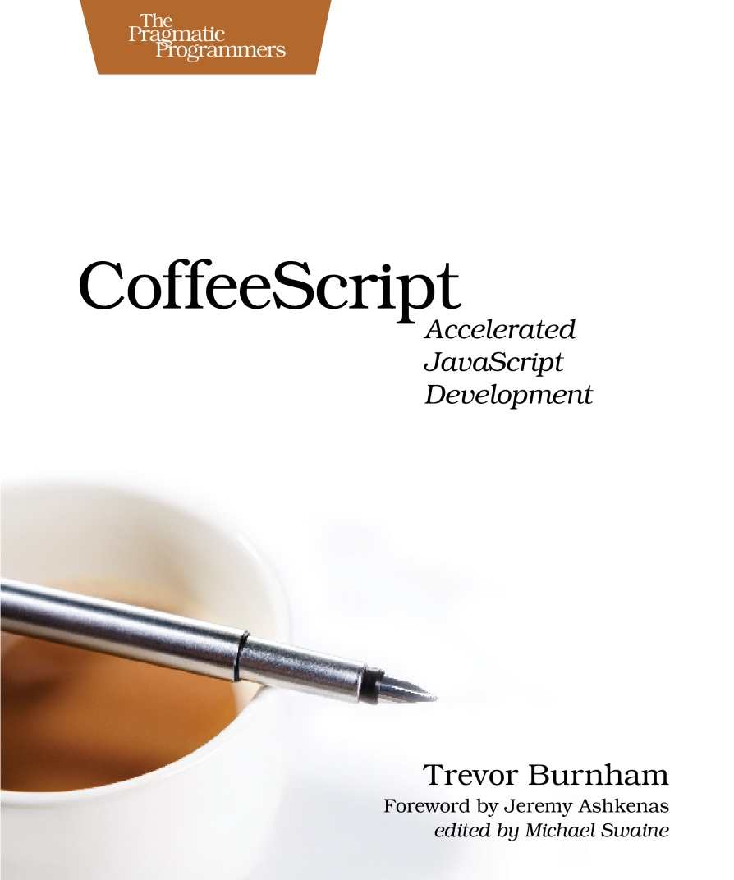
Resources

